Slide 1
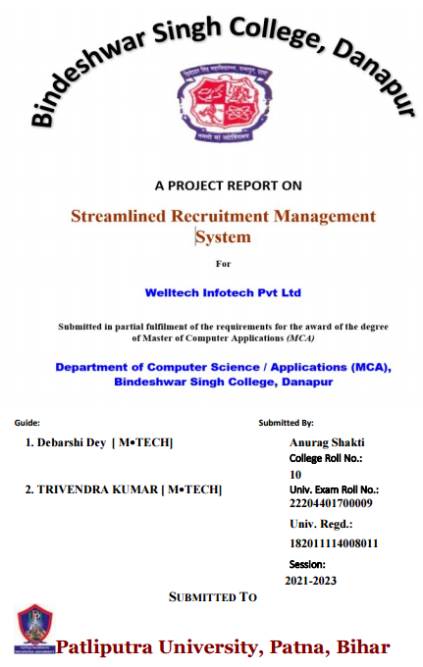

Slide 2
A Software for Recruitment Company - WellTech Infotech Pvt Ltd.
RecruitEasy
A complete solution from process management to performance tracking.

Slide 3
Problem
Recruitment companies need a software solution to help them manage their recruitment process more efficiently and effectively.

Slide 4
Solution:
The Welltech Infotech Pvt Ltd. Recruitment Software is a comprehensive solution that meets the needs of all users, including C-level executives, managers, and recruiters.

Slide 5
Project Overview
Tech Stack Overview:
Utilizing Python with Tkinter for front-end development and SQLite for efficient data management in the Recruitment Management System.
Structured Database Schema:
Employing SQLite to create a robust schema, featuring tables for recruiters, job requirements, submitted candidates, and skills tracking, facilitating streamlined processes and data-driven decision-making.
Development Process Highlights:
The project involves front-end design using Tkinter, SQLite database creation with defined schema and relationships, Python logic for user interactions, integration for real-time data reflection, rigorous testing, debugging, and deployment for an optimized recruitment experience.

Slide 6
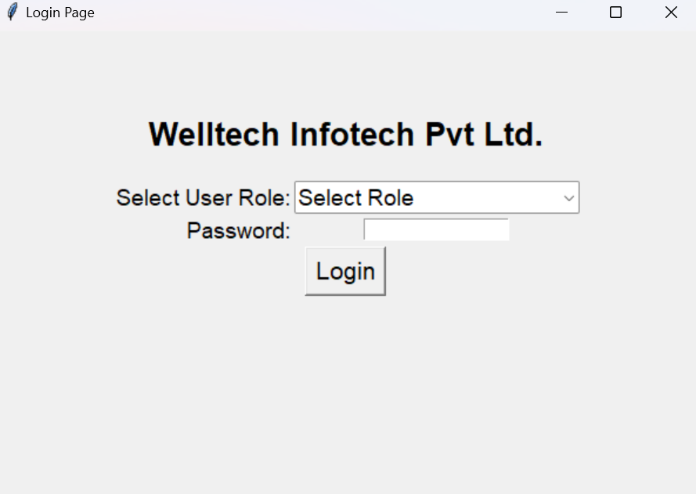
1st page is going to be the Login page.

Slide 7
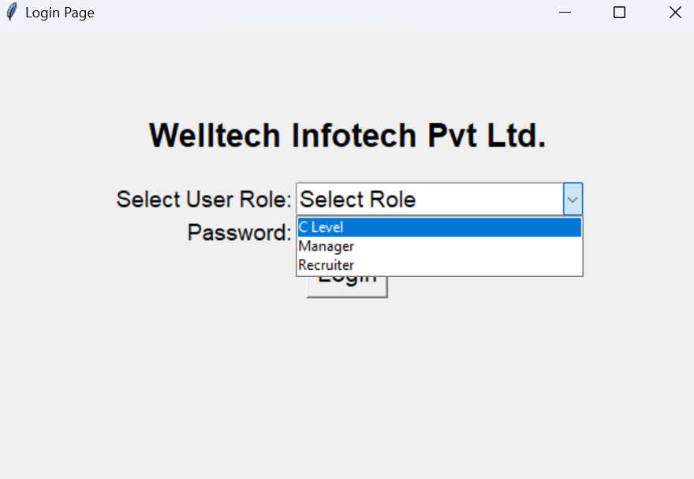
Features
Login page with dropdown to select user type: So there are different user to control the authority and accessibility:

Slide 8
Manager's panel:
Add new requirement button
Requirements section with job details, submitted candidates, and dropdown to change candidate status
Recruiters list with monthly submissions
Recruiter's report (submission number, requirements assigned, interviews, etc.)

Slide 9
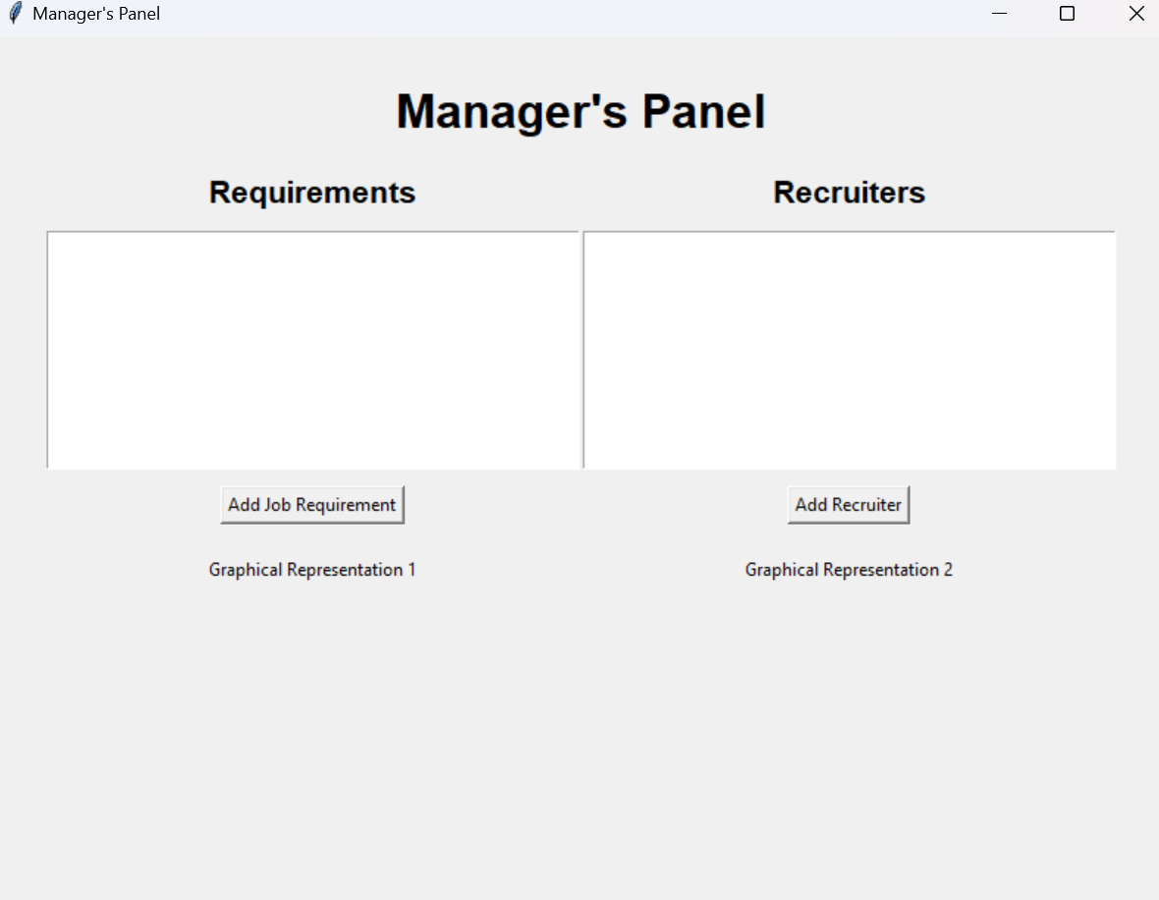

Slide 10
• Recruiter's panel:
o Assigned requirements section
o Messages section (e.g., candidate got an interview)
o Submit candidate button for assigned jobs

Slide 11
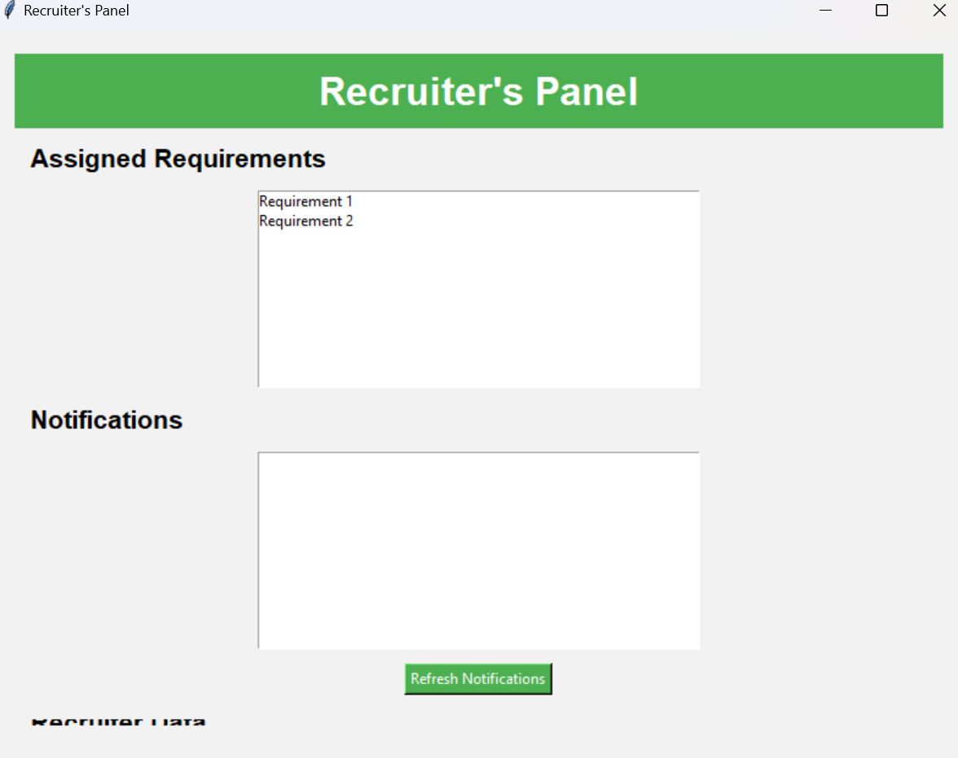

Slide 12
C-level panel:
o Performance of recruiters
o Jobs with number of submissions, placed candidates, and net profit
o Recruiters list with recruiter performance

Slide 13
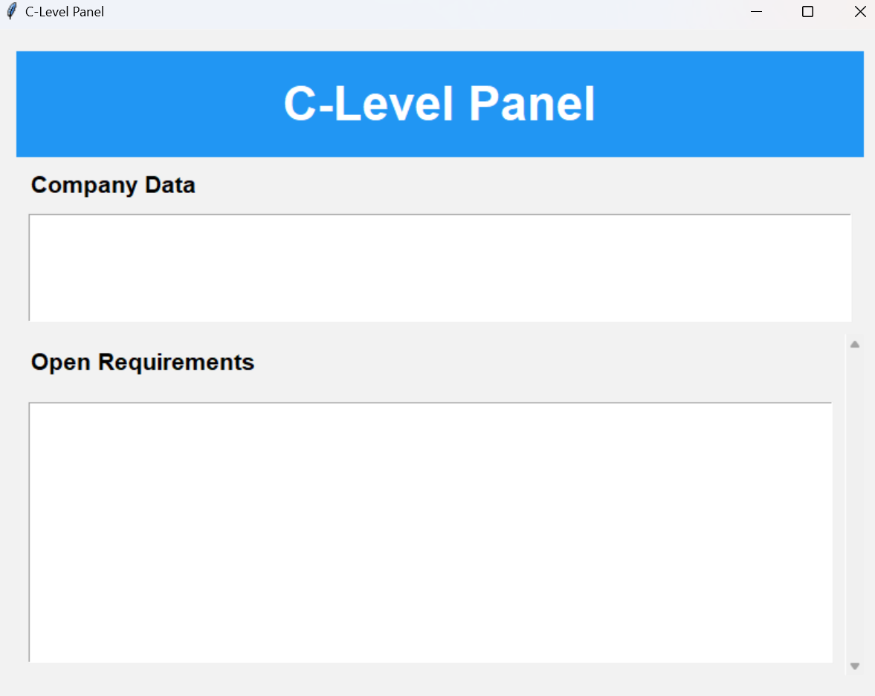

Slide 14
Job Description Pannel
This is an interactive interface for viewing and submitting job requirements, dynamically updating details based on selected job titles, and incorporating a candidate submission feature with skill checkboxes.

Slide 15
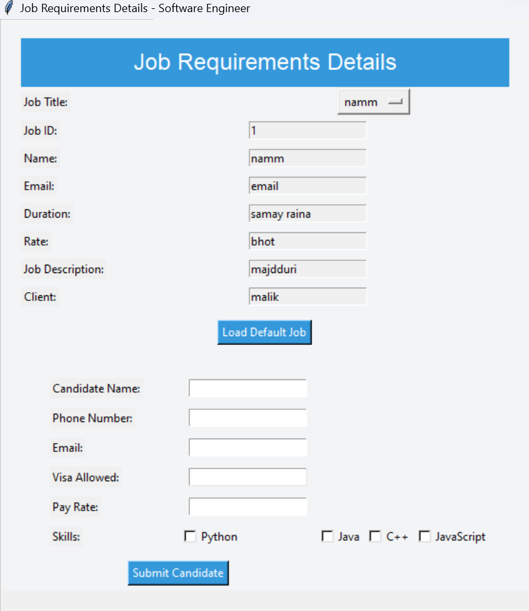

Slide 16
New Job Form
This is the interface for submitting job requirements, extracting skills from the job description, and updating both the "new_job_recruitment" and "recruiters" tables in a SQLite database, allowing for the assignment of recruiters to specific requirements.

Slide 17
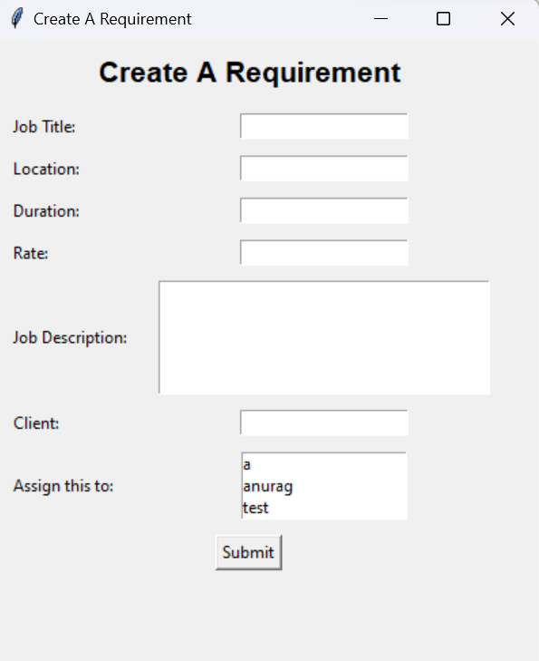

Slide 18
Recruitment Recommendation System
Enhancing managerial decision-making, this system displays job details, facilitates candidate status updates, and intelligently recommends recruiters based on job-specific skills, streamlining the recruitment workflow for optimized efficiency.

Slide 19
Add Recruiter Form
This is an interface for adding recruiter details to a SQLite database, allowing for the insertion of information such as name, email, employee ID, salary, and recruiter type. The entered data is then stored in the "recruiters" table, and a success message is displayed upon successful creation of the recruiter entry.

Slide 20
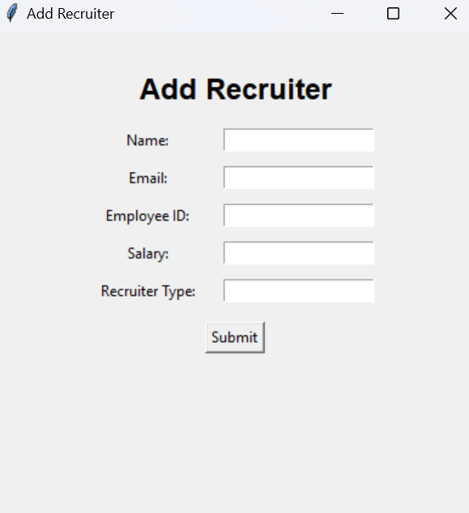

Slide 21
Recruiter’s Details:
This is to create a user interface for adding recruiter details to a SQLite database. It enables the input of information such as name, email, employee ID, salary, and recruiter type. The entered data is then inserted into the "recruiters" table, and a success message is displayed upon successful creation of the recruiter entry.

Slide 22
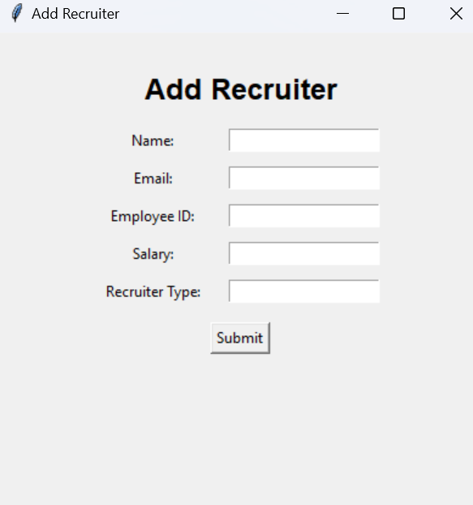

Slide 23
DataBase
Utilizing SQLite for RecruitEasy Database.
The Recruitment Management System adopts SQLite as the database type, providing a lightweight, embedded solution.
The upper view of the structure encompasses tables for recruiters, job requirements, and skills, fostering an organized framework for efficient recruitment processes.

Slide 24
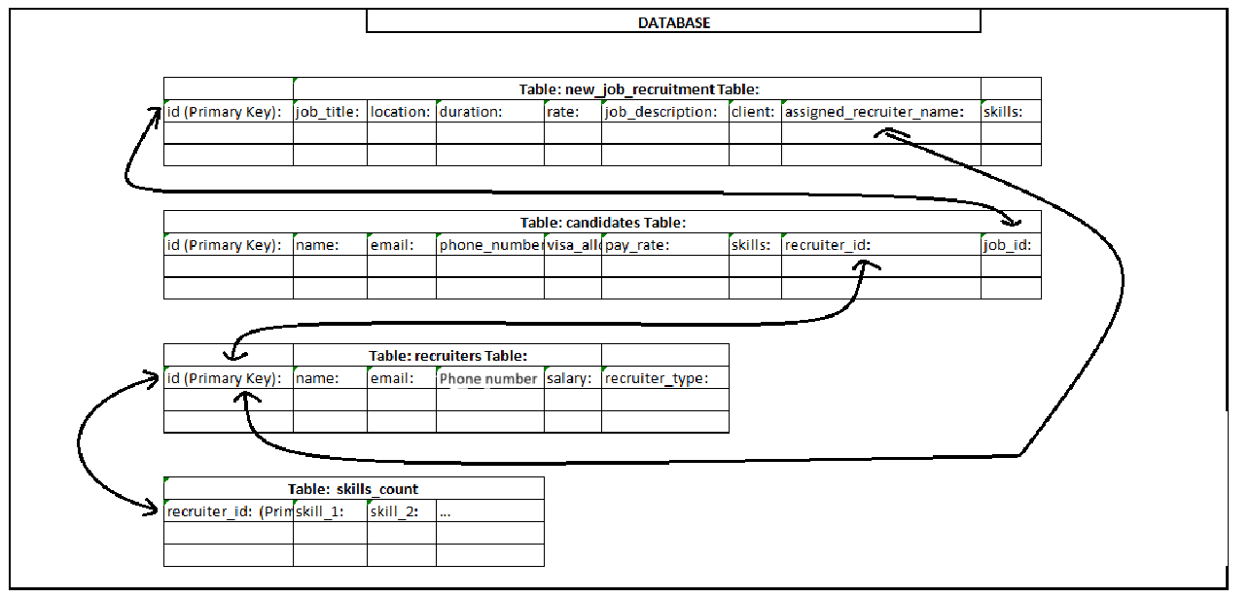
Structure

Slide 25
Benefits
This Recruitment Process Solution Recruitment Software offers a number of benefits to users, including:
Increased efficiency: The software automates many manual tasks, such as posting job openings, screening resumes, and scheduling interviews. This frees up recruiters to spend more time on finding qualified candidates.
Better decision-making: The software provides managers and C-level executives with real-time data and insights into the recruitment process. This helps them make better decisions about hiring and staffing.
Performance Tracking: Gives a through out overview of the performance of the employees, this will help to rectify the problem even before it starts.

Slide 26
Lastly
This Recruitment Process Solution Software is a powerful and comprehensive solution that can help recruitment companies of all sizes improve their efficiency, candidate experience, and decision-making.

